Slide 1
Introduction to Distributed Systems
Dhaval Joshi
Assistant Professor
M.Sc.(I.T./I.C.T.) Programme,
Veer Narmad South Gujarat University,
Surat.

Slide 2
Distributed Systems
Definition :
A system in which H/W and S/W components located at networked computers communicate and coordinate their actions only by passing messages.

Slide 3
Why Distributed System?
Sharing resources and ensuring availability of it.
E.g. :
1)Hardware like printer, camera, disk space, etc.
2)Information and Communication like databases, files, mobile phones, etc.
3)Media and Entertainment like music, video, etc.

Slide 4
Examples of Distributed Systems
Internet
Intranet
Mobile and Ubiquitous Systems

Slide 5
Internet
Large interconnected collection of computers
Interaction is via message passing
Various Protocols help with messages
  IP
  TCP
  UDP
  FTP
  HTTP

Slide 6
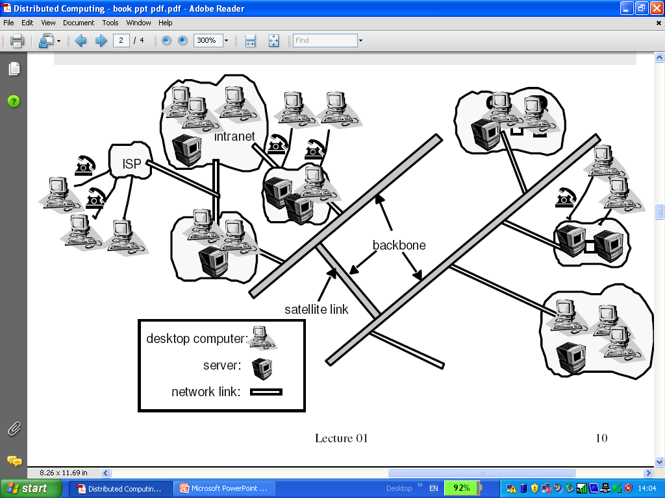
Internet

Slide 7
Intranet
Portion of the Internet that is separately administrated and has a boundary to configured to enforce local security policies.

Slide 8
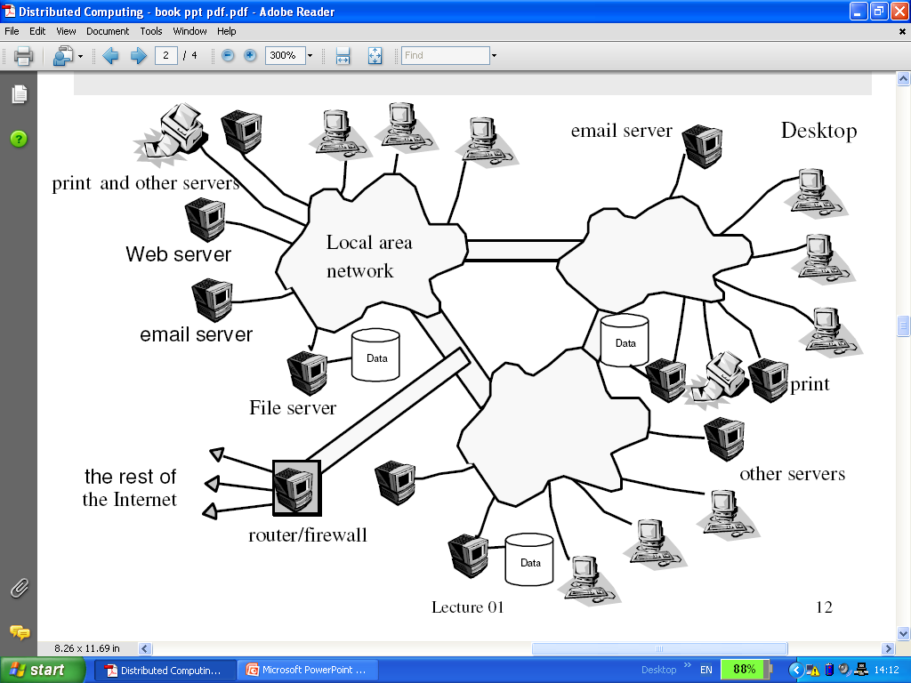
Intranet

Slide 9
Mobile and Ubiquitous computing
It is the harnessing of many small, cheap computational devices that are present in users’ physical environment.

Slide 10
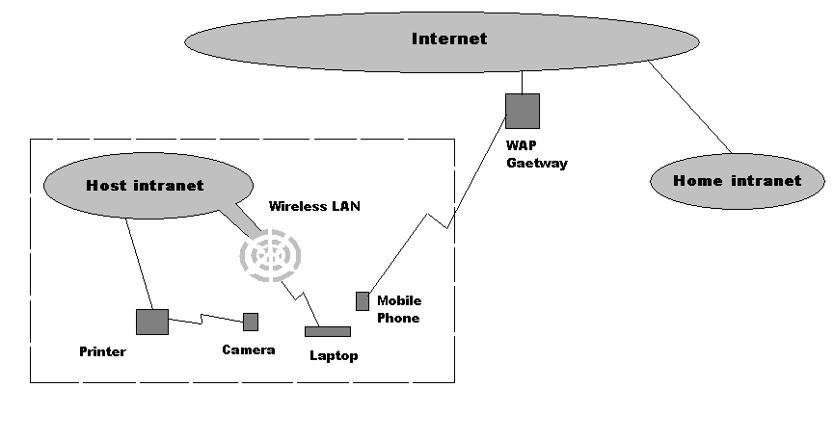
Mobile and Ubiquitous computing

Slide 11
Challenges of Distributed Systems
Heterogeneity
Openness
Security
Scalability
Failure handling
Concurrency
Transparency

Slide 12
Heterogeneity
System must work on different networks, hardware, OS, Programming Language and also implementation by different people.
It can be done by using proper standards.
Middleware – programming abstraction as well as masking the heterogeneity.
Like mobile code (Applets) and virtual machine.

Slide 13
Openness
Extensibility – The system can be extended and re-implemented in various ways.
It should allow new addition in system like,
New H/W – more computers,
S/W – support of new file format,
Services and
Sharing resources.
It can be done by publishing interfaces.

Slide 14
Security
Confidentiality – protection against disclosure to unauthorized individuals.
Integrity – protection against alteration and corruption.
Availability – protection against interference with the means to access the resources.

Slide 15
Scalability
Remain effective when there are significant increase in number of resources and users.
Controlling the cost of physical resources.
Controlling the performance loss.
Preventing resources from running out.
Avoid performance bottlenecks.

Slide 16
Failure Handling
Failure detection is partial and also difficult.
Detecting failure – few are impossible to detect.
Masking failure – retransmission
Tolerating failure
Recovery from failure – role back in DB (Transaction)
Redundancy – duplicate data

Slide 17
Concurrency
Services and resources are shared by the clients in a distributed systems.
Correct synchronization is essential.
e.g. Online Shopping

Slide 18
Transparency
Concealment of the distributed nature of system from user or programmer.
Access Transparency
Location Transparency
Concurrency Transparency
Replication Transparency
Failure Transparency
Mobility Transparency

Slide 19
Types of Computing

Slide 20
Types of Computing
Parallel Computing
Cluster Computing
Grid Computing
Utility Computing
Cloud Computing

Slide 21
Parallel Computing
A form of computation in which many calculations are carried out simultaneously.
Large problems can often be divided into smaller ones, which are then solved concurrently ("in parallel")

Slide 22
Cluster Computing
A computer cluster is a group of linked computers, working together closely so that in many respects they form a single computer.
The components of a cluster are commonly, but not always, connected to each other through fast local area networks.
Clusters are usually deployed to improve performance and/or availability over that provided by a single computer, while typically being much more cost-effective than single computers of comparable speed or availability.

Slide 23
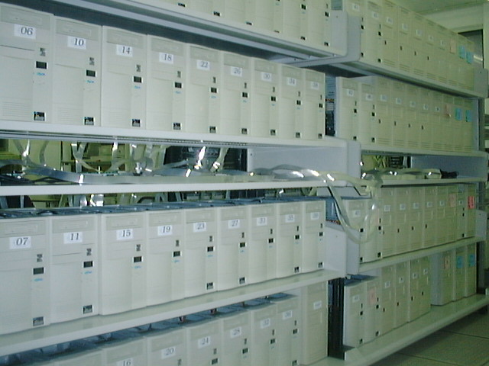
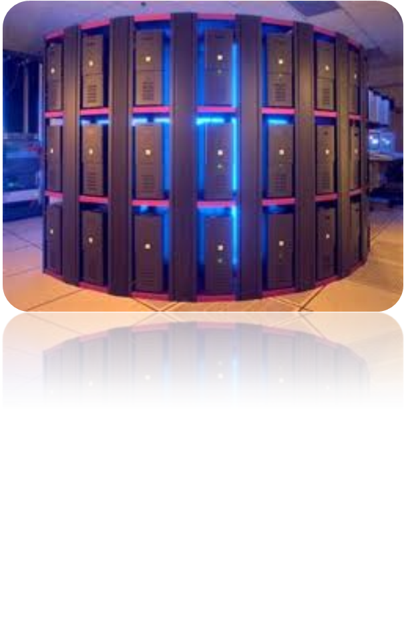




Cluster Computing
Workstation
Mainframe
PC
Mini Computer

Slide 24
Grid Computing
To coordinate resource sharing and problem solving in dynamic, multi-institutional virtual organization (VO).
Provide the generic approach for a general resource-sharing framework that address the VO requirement.
Support the creation and use of computation- and data-enriched environments.
Uses open standards and interfaces.

Slide 25
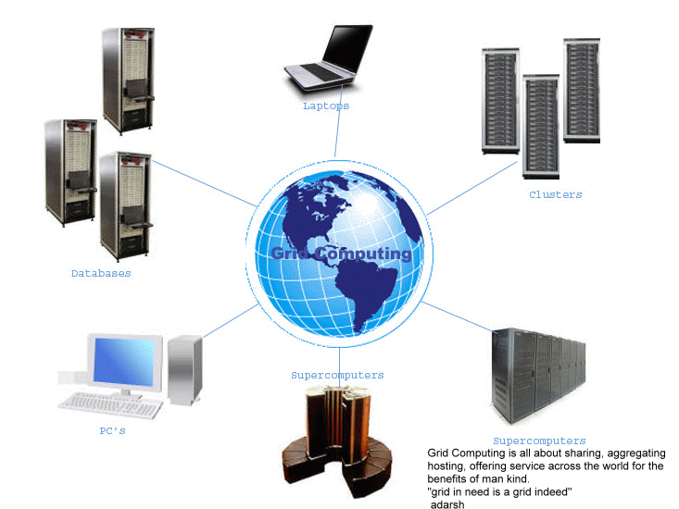
Grid Computing

Slide 26
Grid Topologies
Intragird
  Local grid within an organization
  Trust based on personal contracts
Extragird
  Resources of a consortium of organizations connected through a (Virtual) Private Network
  Trust based on Business to Business contracts
Intergrid
  Global sharing of resources through the internet
  Trust based on certification

Slide 27
Types of Grid
Computational Grid
  A computational grid is a hardware and software infrastructure that provides dependable, consistent, pervasive, and inexpensive access to high-end computational capabilities.

Slide 28
Types of Grid
Data Grid
  Deals with data — the controlled sharing and management of large amounts of distributed data.
  A storage component of a grid environment.
  Scientific and engineering applications require access to large amounts of data, and often this data is widely distributed. A data grid provides seamless access to the local or remote data required to complete compute intensive calculations.

Slide 29
Grid Middleware
Grids are typically managed by grid ware - a special type of middleware that enable sharing and manage grid components based on user requirements and resource attributes. (e.g., capacity, performance)
Software that connects other software components or applications to provide the following functions:
  Run applications on suitable available resources
  Provide uniform, high-level access to resources
  Address inter-domain issues of security, policy, etc.
  Provide application-level status
  Monitoring and control

Slide 30
END

